Slide 1
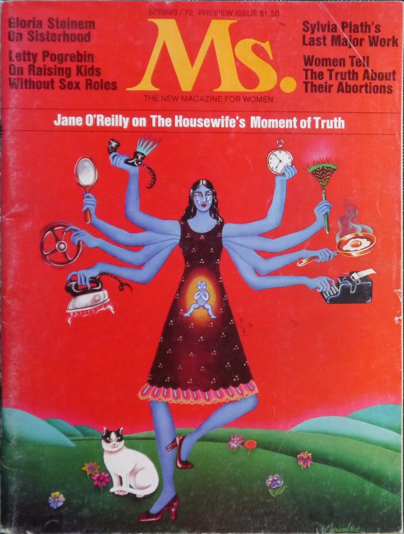
This Photo by Unknown Author is licensed under CC BY-SA-NC

Slide 2
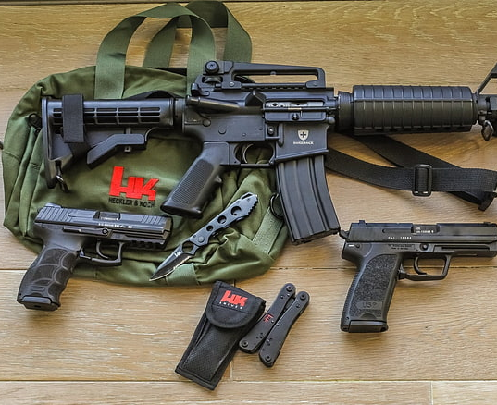
Supremacy Crime

Slide 3
DAY OF RETRIBUTION by ELLIOT RODGER
This Photo by Unknown Author is licensed under CC BY-SA-NC

Slide 4
MONTREAL MASSACRE
This Photo by Unknown Author is licensed under CC BY-NC

Slide 5
PITTSBURG AEROBICS CLASS
This Photo by Unknown Author is licensed under CC BY

Slide 6
#NotAllMen
This Photo by Unknown Author is licensed under CC BY-SA-NC

Slide 7
This Photo by Unknown Author is licensed under CC BY-NC-ND

Slide 8
SAINT ELLIOT DAY

Slide 9
Mass Shootings & Domestic Violence & Toxic Masculinity
This Photo by Unknown Author is licensed under CC BY-SA

Slide 10
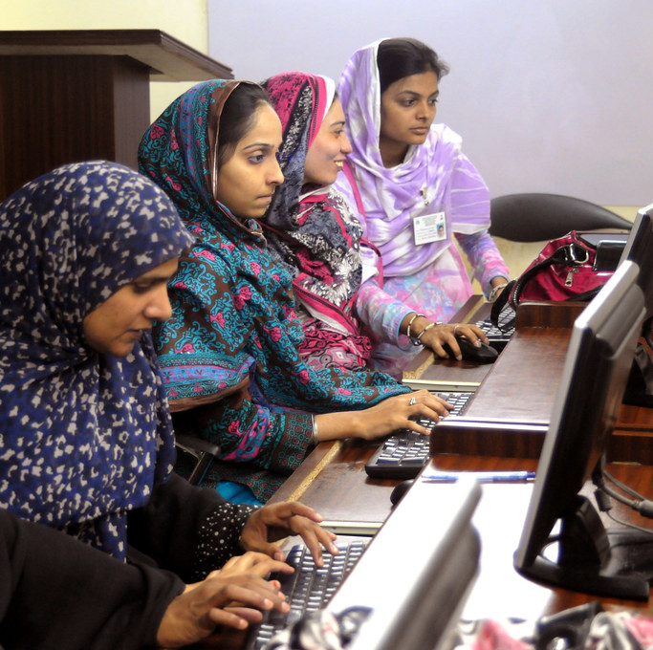
Isla Vista “helped regalvanize women in important ways … there is no time for complacency” (Gish Jen).
This Photo by Unknown Author is licensed under CC BY-NC-ND

