Slide 2
R for Data Analysis
4/26/24
Academic Showcase

Slide 3
R programming
Statistics
Big data analysis
Data management
Ecology, social sciences, bioinformatics

Slide 4
Different programs
Excel
  Easy to learn
  Weak limited
  $
SAS
  faster
  secure
  Poor data management
  $$$
  Academia
SPSS
  Better data management than SAS
  $$
  Industry

Slide 5

R
Powerful
Big Data fast
Free
Open-source
Graphing versatility
User groups
Python and R required for bioinformatics

Slide 6
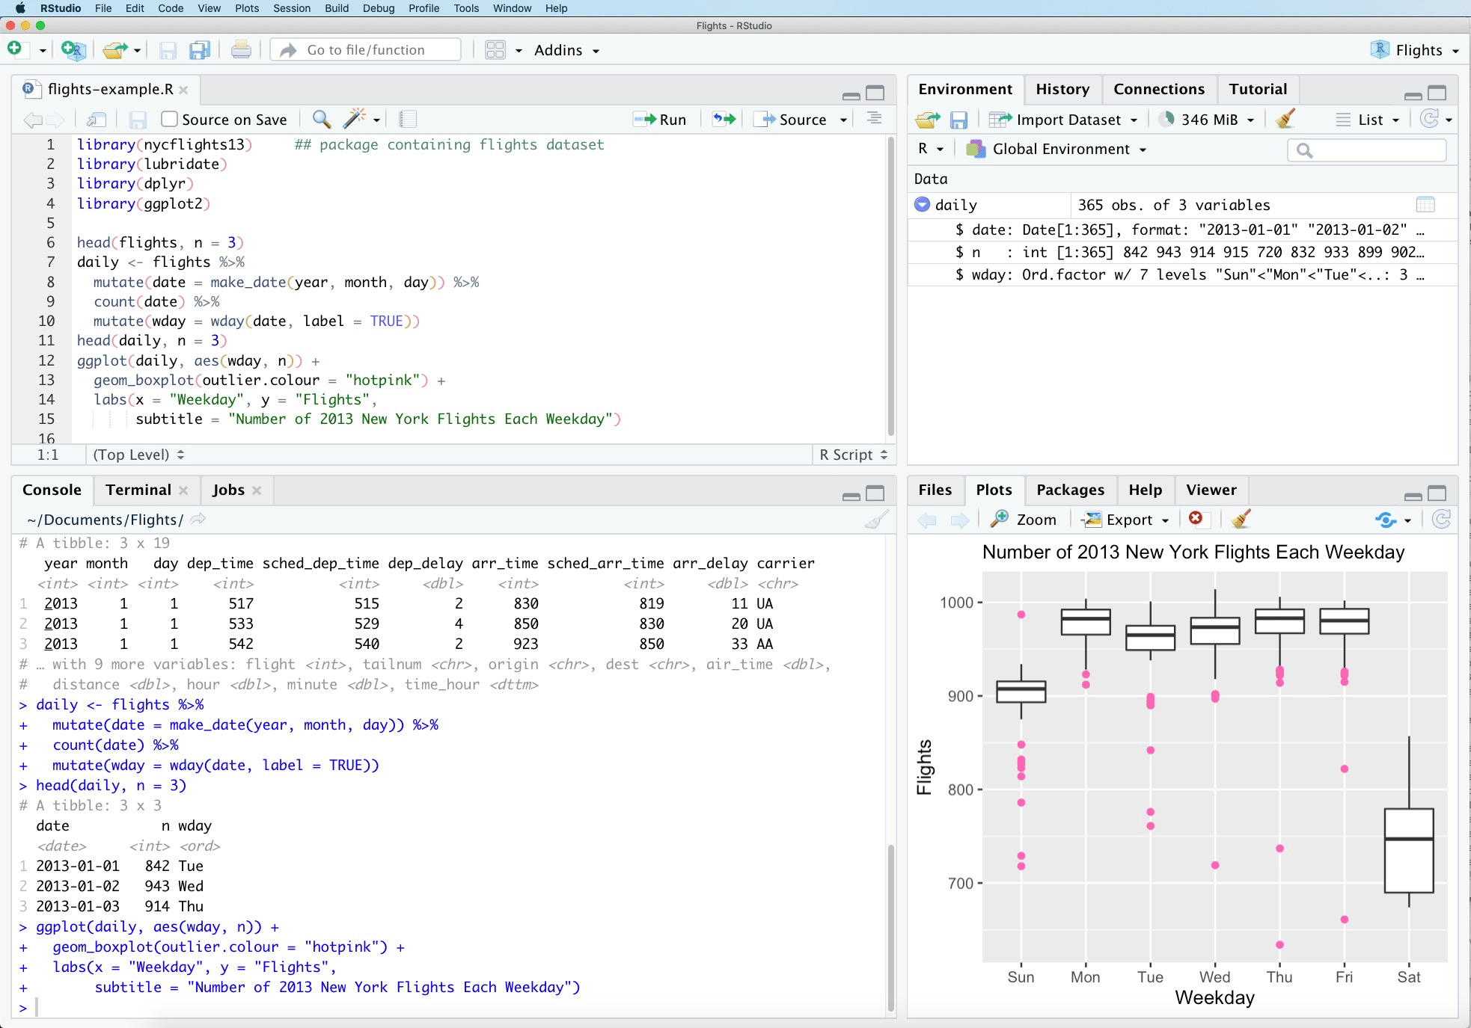
Learning curve
Programming
Syntax
Flexible
Rstudio

Slide 7
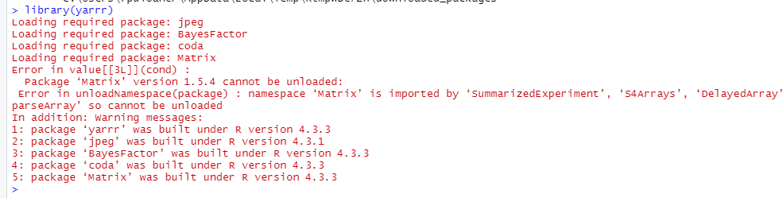
Calculations -statistics
Significant difference in age between pirates that wear headbands and those that do not
t.test(formula = age ~ headband,
data = pirates,
alternative = 'two.sided')

Slide 8
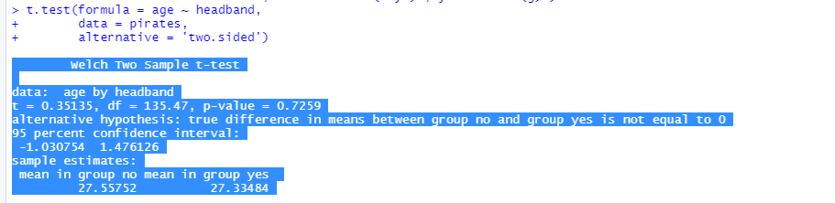
Calculations -statistics
P value >0.7 n.s.

Slide 9
Statistics
Correlation between pirate height and weight?
cor.test(formula = ~ height + weight, data = pirates)

Slide 10
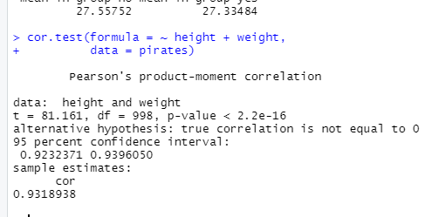
Statistics
Correlation between pirate height and weight?
cor.test(formula = ~ height + weight, data = pirates)
P<10⁻¹⁶ !!

Slide 11
Statistics - linear regression model
- DV = tchests, IV = age, weight, tattoos
tchests.model <- lm(formula = tchests ~ age + weight + tattoos, data = pirate)

Slide 12
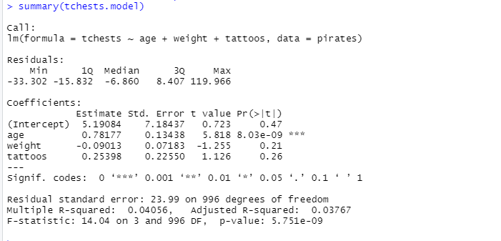
Statistics - linear regression model
- DV = tchests, IV = age, weight, tattoos
tchests.model <- lm(formula = tchests ~ age + weight + tattoos, data = pirate)
summary(tchests.model)

Slide 13
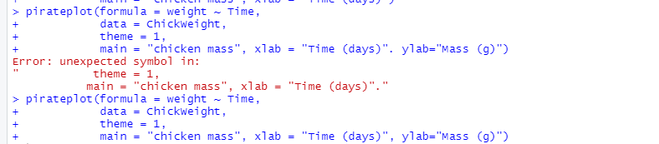
Graphing!

Slide 14
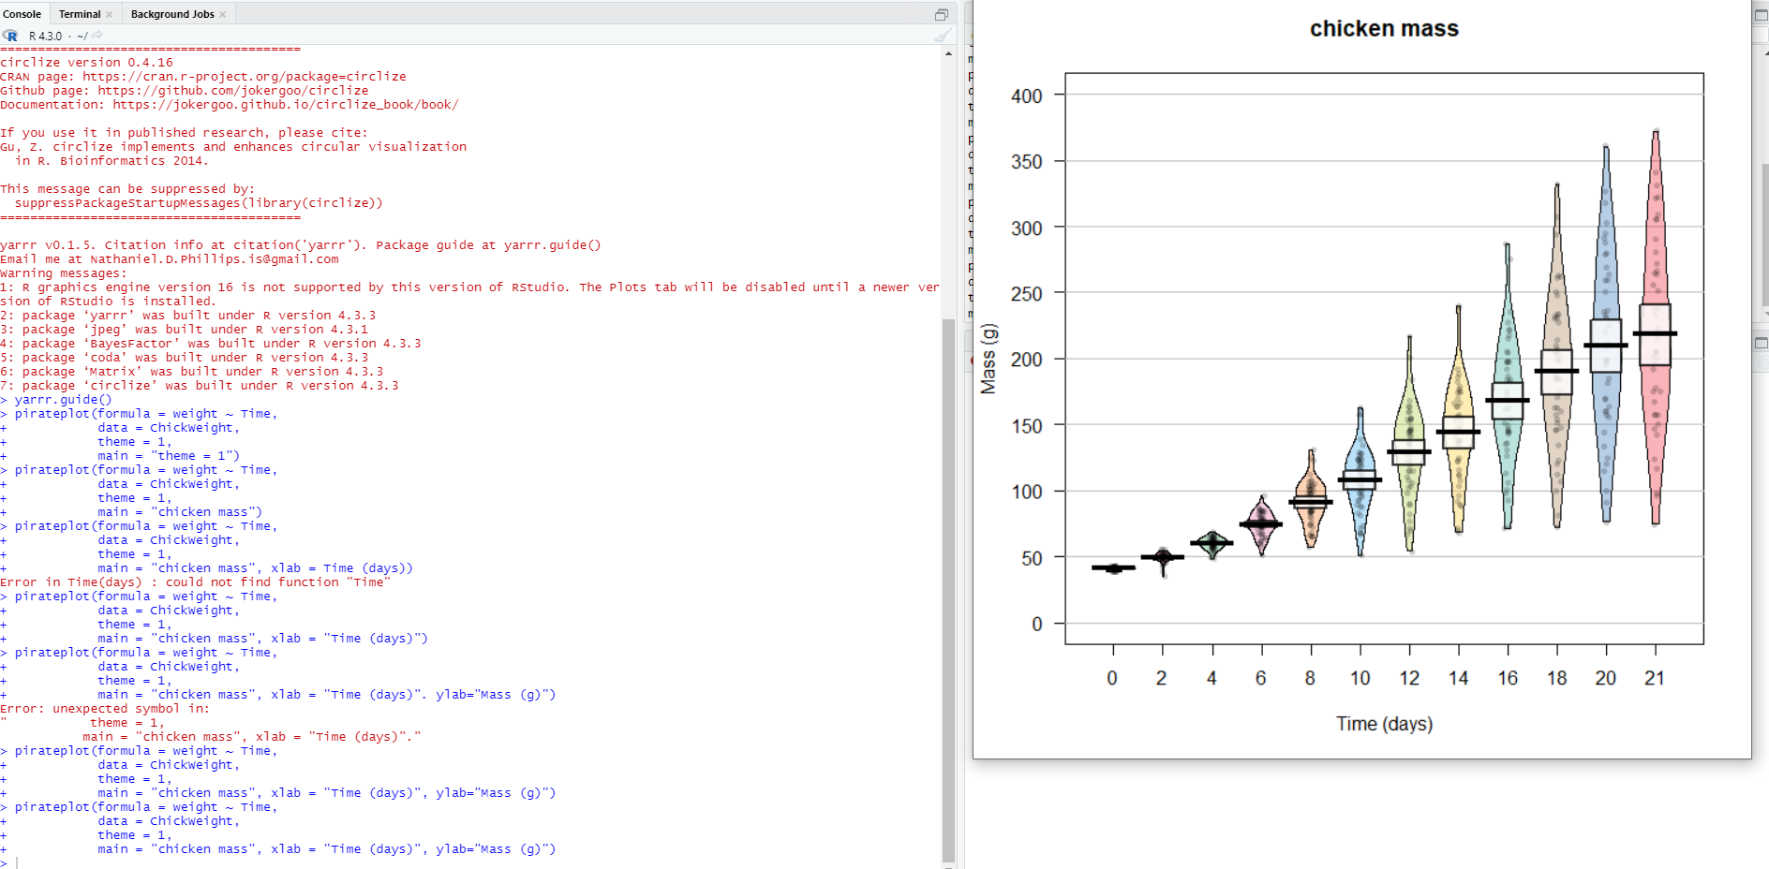

Slide 15
back.col = transparent("blue", .95), # Add light blue background
gl.col = "gray", # Gray gridlines
gl.lwd = c(.75, 0), inf.f.o = .6, # Turn up inf filling
inf.disp = "bean", # Wrap inference around bean
bean.b.o = .4, # Turn down bean borders
quant = c(.1, .9), # 10th and 90th quantiles
quant.col = "black") # Black quantile lines

Slide 16
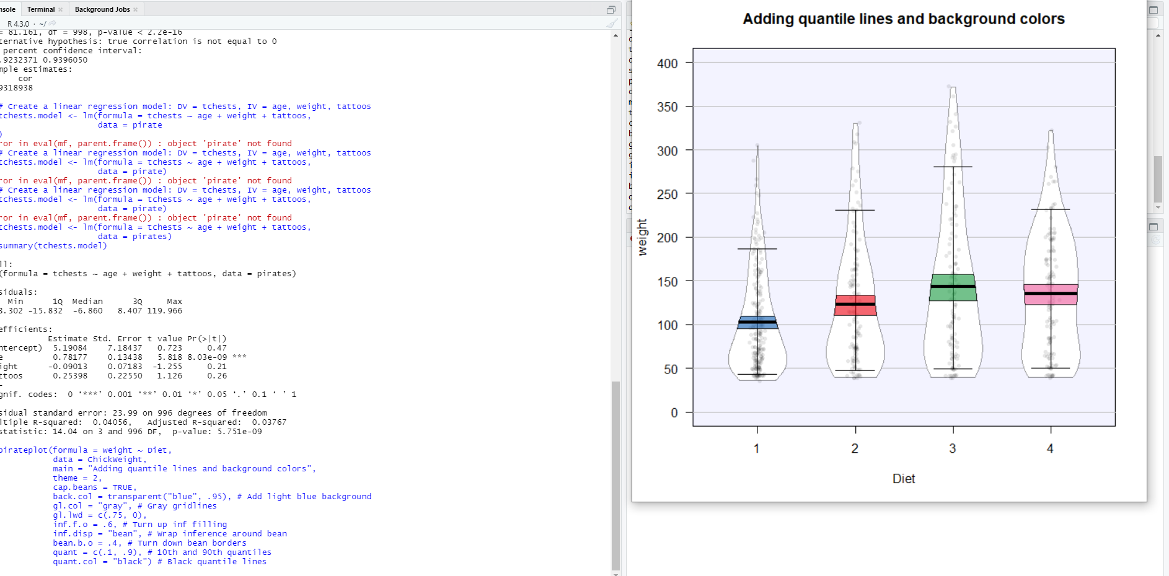

Slide 17
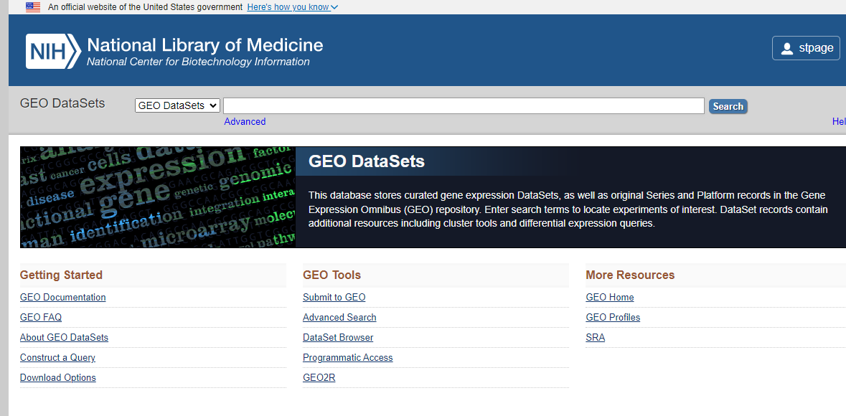
Big Data!
4000 datasets
150,000
5 million samples 50-150 MB each
>1000 TB.

Slide 18
Dataset
Breast cancer database – gene expression
Subset – just 20 variables

Slide 19
Power
PCA

Slide 20
Power
PCA

Slide 21
PCA

Slide 22
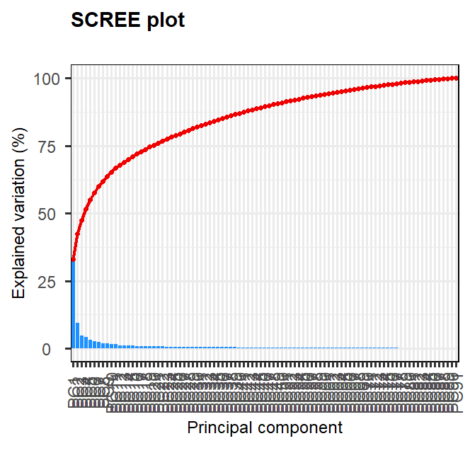
PCA Scree plot

Slide 23
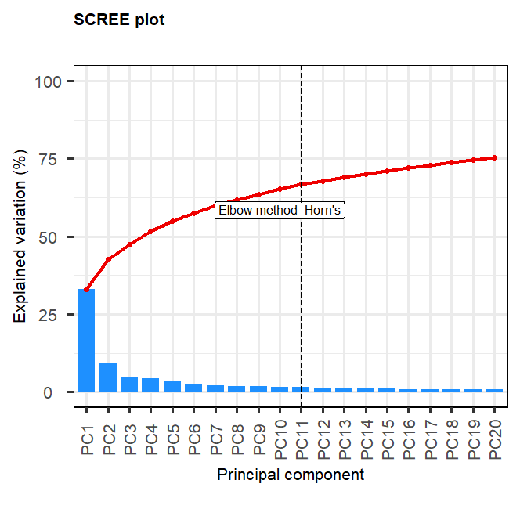
Optimal number of variables cutoff Horn’s parallel and elbow method

Slide 24
Individual gene expression

Slide 25
Volcano plot
Individual gene expression

Slide 26
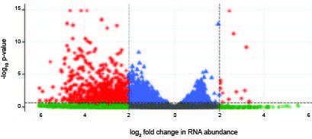
Volcano Plot – my data

Slide 27
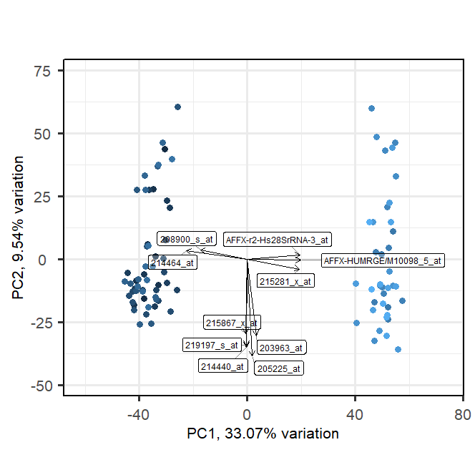
Gene with largest eignvectors

Slide 28
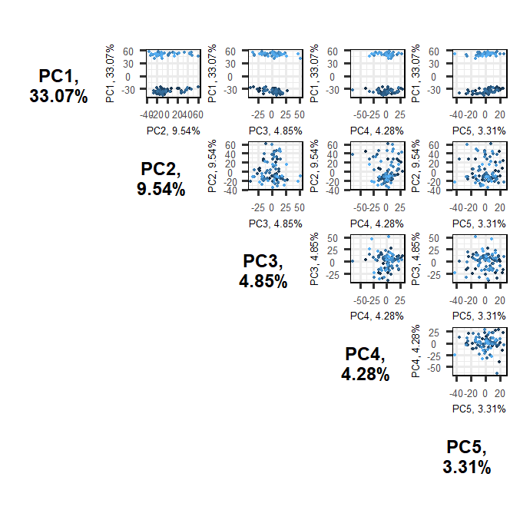
Pairwise comparison of genes

Slide 29
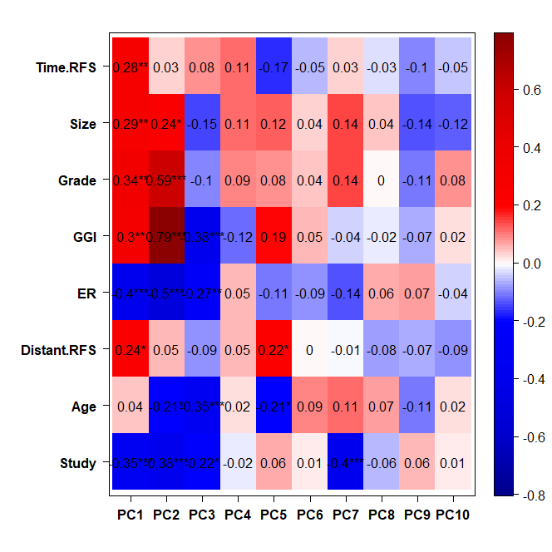
Heat map of variables

Slide 30
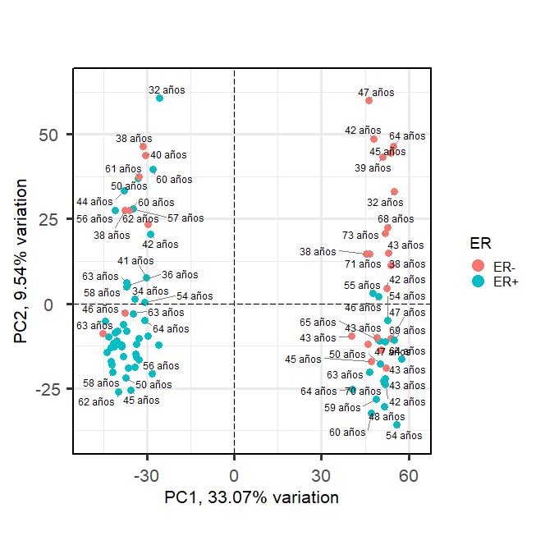
Variation due to age and estrogen receptor

Slide 31
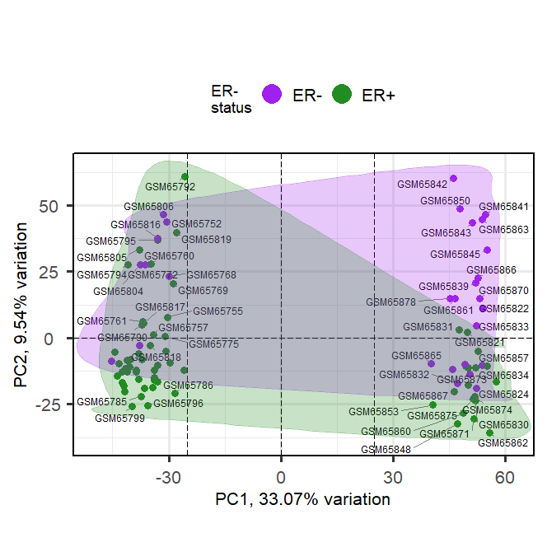
Variation due to age group estrogen receptor

