Slide 1
The Impact of Digital Disinformation on Immigration Discourse in Europe: A comparative analysis of Spain and Germany
Gabriela Sánchez-Parodi Reverón

Slide 2
Nature and Scope of Digital Disinformation
Digital Disinformation
Fake news
Propaganda
Hate speech

Slide 3
Far Right Political Parties
Alternative for Germany party (AfD)
Extreme right wing party
Strong anti-immigration focus
German Politician Gottfried Curio
VOX party in Spain
Founder: Ivan Espinosa de los Monteros
Both parties found in 2013

Slide 4
Role of Social Media Platforms
Facebook- large user community
Twitter- hashtags, retweets
Youtube- video- sharing platform
Whatsapp- circulation of unverified information
Snapchat- very popular among teenagers
TikTok- Visual storytelling

Slide 5
Spanish Data
Studied carried out in Spain between November 2018 and April 2019
240,000 tweets analyzed
Political Party VOX
1,977 tweets included forms of hate speech toward immigrants
42% incitement to hate, offensive expressions
56% including offenses, threats physical and psychological
2% violent speech
Targeted Immigration and Islam
Offensive expression
Source: Calderón, Carlos Arcila, Gonzalo de la Vega, and David Blanco Herrero. 2020. "Topic Modeling and Characterization of Hate Speech against Immigrants on Twitter around the Emergence of a Far-Right Party in Spain" Social Sciences 9, no. 11: 188.

Slide 6
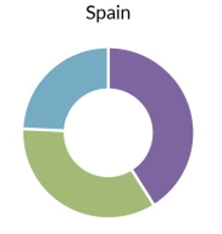
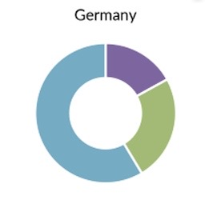
Data
Frames used in media coverage to portray immigrants
Health
potential carries of COVID-19
Wealth
portrayed as exploiting social benefits
competing unfairly for Jobs
burdening community resources
Identity
Invading force
Challenging European tradition
Part of conspiracy to replace white Europeans
Source:
Butcher, Paul, and Alberto-Horst Neidhardt . “Fighting Disinformation on Migration with Alternative ...” EPC, 26 Nov. 2020, www.epc.eu/content/PDF/2020/Disinformation_on_Migration.pdf.

Slide 7
Germany´s law against disinformation
Germany´s Network Enforcement Law (NetzDG)
Enact in 2017 by the Bundestag
Combat hate speech, terrorism and fake news
Social media companies receive complaints about unlawful content
Over 2 million German users
Violates any of the 18 specific rules in German criminal law
24 hours to remove content
Fines up to 6 million dollars

Slide 8
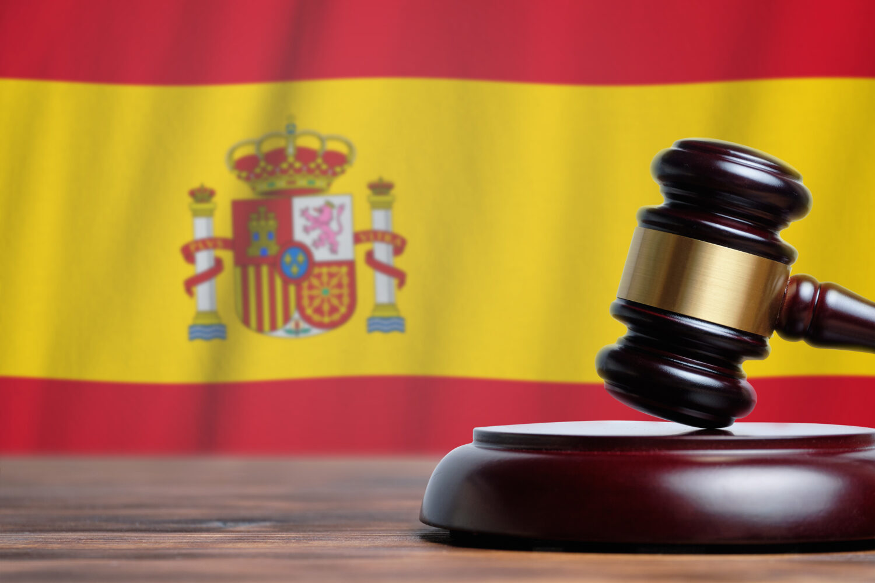
Spanish law against disinformation
Article 510 of the Penal Code
Address concerns about discrimination, hate speech, and violence
Incite terrorism
Glorify terrorist activities
Promote hate and violence based on factors such as ethnicity, nationality, religion, or ideology
Safeguard public safety and social harmony
Prevent extremist ideologies
Mitigate the potential harm

Slide 9
Strategies to combat disinformation
Fact-checking initiatives
Educate new generations
Implement laws and policies
Verify before sharing
Explore other information Sources

Slide 10
Sources
Bartsch, M., & Clau Szlig;, A. (2016). Far-right misinformation stokes anti-refugee sentiment. Retrieved from https://www.spiegel.de/international/germany/far-right-misinformation-stokes-anti-refugee-sentiment-a-1070413.html
Gesley, Jenny. “Germany: Network Enforcement Act Amended to Better Fight Online Hate Speech.” The Library of Congress, 2021, www.loc.gov/item/global-legal-monitor/2021-07-06/germany-network-enforcement-act-amended-to-better-fight-online-hate-speech/.
Imara McMillan. Enforcement through the network: The Network Enforcement Act and Article 10 of the European Convention on Human Rights. Chicago Journal of International Law.
Essalhi-Rakrak, Abdellah, and Ruth Pinedo-González. “#españainvadida. Disinformation and Hate Speech towards Refugees on Twitter: A Challenge for Critical Thinking.” Profesional de La Información / Information Professional, revista.profesionaldelainformacion.com/index.php/EPI/article/view/87188.
Serrano, Raquel Miguel. ¨Disinformation Landscape in Germany¨ EU Disinfo Lab. March 2023. https://www.disinfo.eu/wp-content/uploads/2023/03/20230224_GER_DisinfoFS.pdf
Neidhardt, A.-H., & Butcher, P. (2020). Fear and lying in the EU: Fighting disinformation on migration with alternative narratives. Retrieved from https://www.epc.eu/en/publications/Fear-and-lying-in-the-EU-Fighting-disinformation-on-migration-with-al~39a1e8
https://www.article19.org/wp-content/uploads/2020/03/Spain-Penal-Code-analysis-March-2020-Final.pdf

